Slide 1
TechM Footprint in OSS BSS
- Prakash Kajave

Slide 2
Objectives
At the end of this session, you will be able to:
  COTS product segregation in BSS, OSS and NMS area
  TechM’s footprint in BSS, NMS and OSS COTS
  TechM’s footprint in RA&FM
CONFIDENTIAL© Copyright 2007 Tech Mahindra Limited

Slide 3
Agenda
TechM’s OSS BSS NMS COTS Capabilities
CONFIDENTIAL© Copyright 2007 Tech Mahindra Limited

Slide 4
TechM’s OSS BSS COTS Capabilities
Terradata
SAP
OBI
Geneva RBM
LHS BSCS iX
Oracle BRM
Kenan Arbor
Intec
AMDOCS suite
Siebel
Clarify
MSDCRM
Business Intelligence
Oracle Financials
Roaming
Customer Relationship management
Financial
Management
Revenue Assurance
Fraud Management
Subex
Guardian
Remedy
Siebel
IBM Tivoli
PriceMaker
Oracle BRM
LHS BSCS iX
Geneva RBM
Amdocs suite
Intec Singleview
Unicorn
Geneva RBM
LHS BSCS iX
Oracle BRM
Keenon Arbor
Amdocs suite
Intec Singleview
Unicorn
Order Management
Intec InterconnectSubex
Azure
cVidya
Connectiva
Trouble Ticketing
Metasolv
Crammer
AXIOSS
Clarity
Interconnect
Openet FW
Intec Intermediate
Comptel EL
Digital -Route
Reporting
Rating
Billing
NetEXPERT
HPOV
Clarity
Netcool
Concord eHealth
Business Objects
Crystal Reports
Mediation
Provisioning & Act
Inventory
Service
Assurance
Metasolv M6,UIM
Comtel NI
Crammer Granite
Integration Framework
Network
CONFIDENTIAL© Copyright 2007 Tech Mahindra Limited

Slide 5
Summary
In this session, we covered:
  TechM’s footprint in OSS, BSS and NMS area
CONFIDENTIAL© Copyright 2007 Tech Mahindra Limited

Slide 6


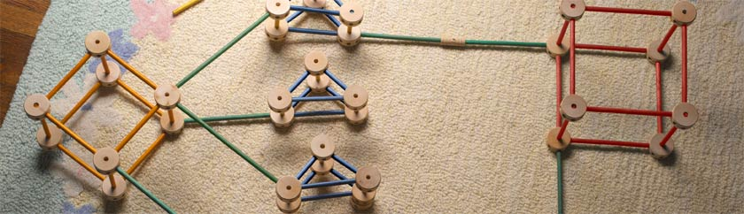
Any Queries …
&
Questions
Answers
CONFIDENTIAL© Copyright 2007 Tech Mahindra Limited

